Slide 1
Phase 3: Instagram Revision
Making it easier to finding a post you’ve saved.

Slide 2
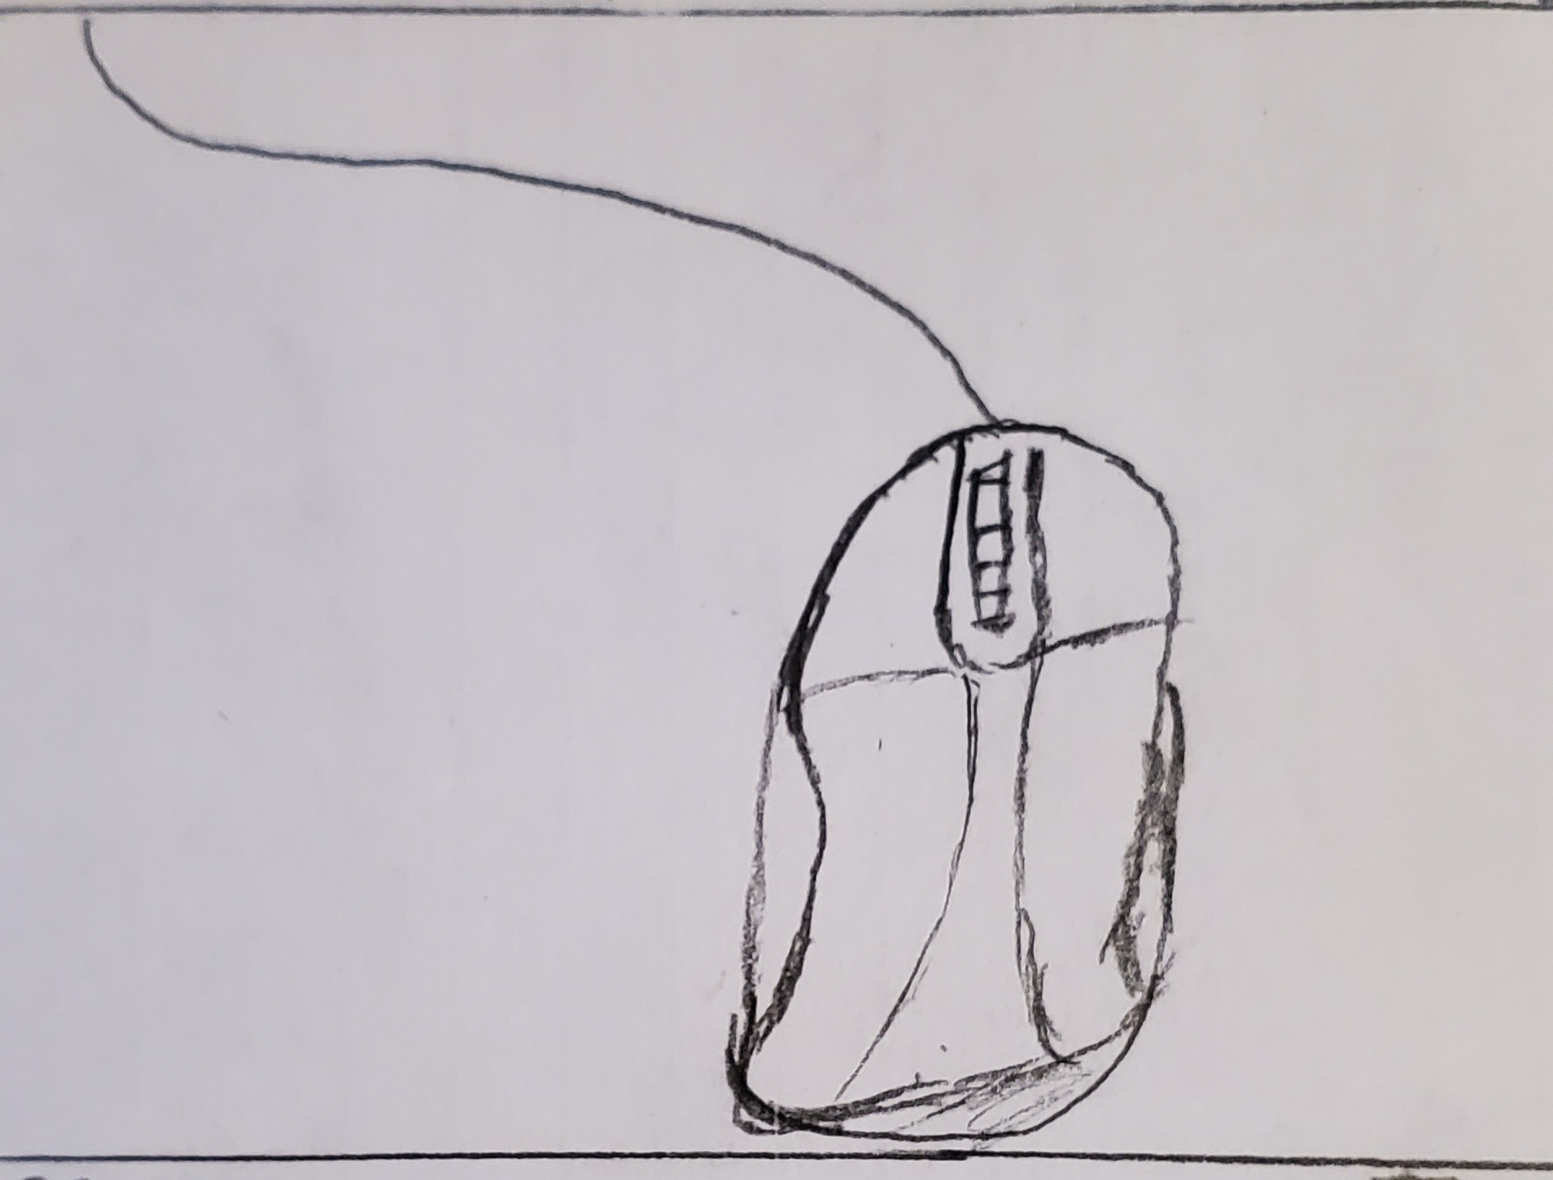
The Process:
Find this Image:
Step 1) Open the application
Step 2) Tap on Profile button in bottom left corner.
Step 3) Tap on Profile options pullout.
Step 4) Tap on “Saved” option in Profile Options pullout.
Step 5) Tap Filter icon to open the filter options.
5a. Select a folder
5b. Select a post type
5c. Select Account order
5d. Select organization of the first Hashtag.
Revised 5d. Type in Hashtag being searched.
Step 6) Tap Input to apply the filter options to Saved Posts.
Step 7) Tap Image.

Slide 3
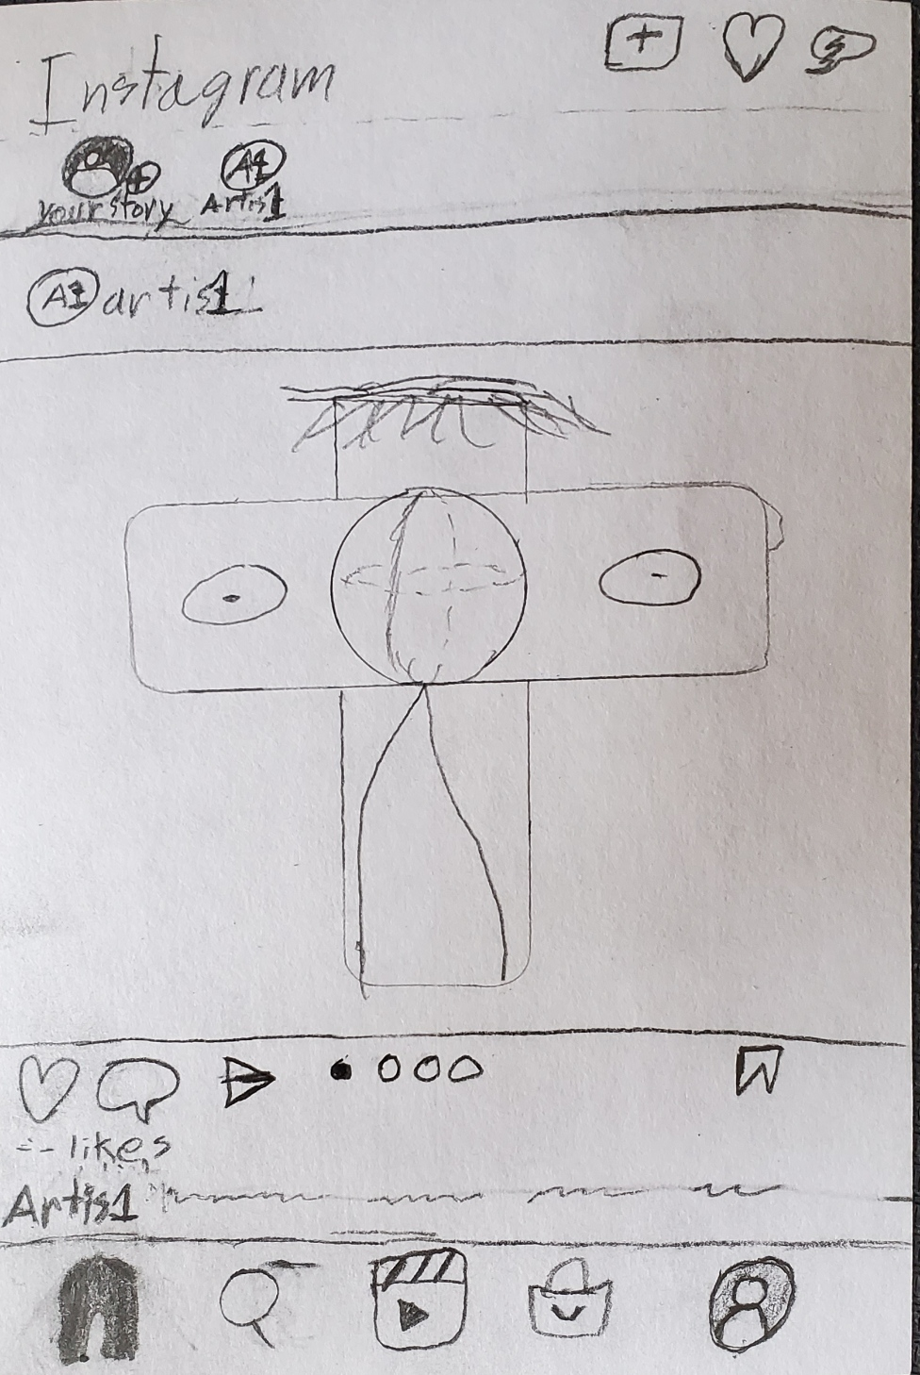
The Prototype: Step 1: Home Screen

Slide 4
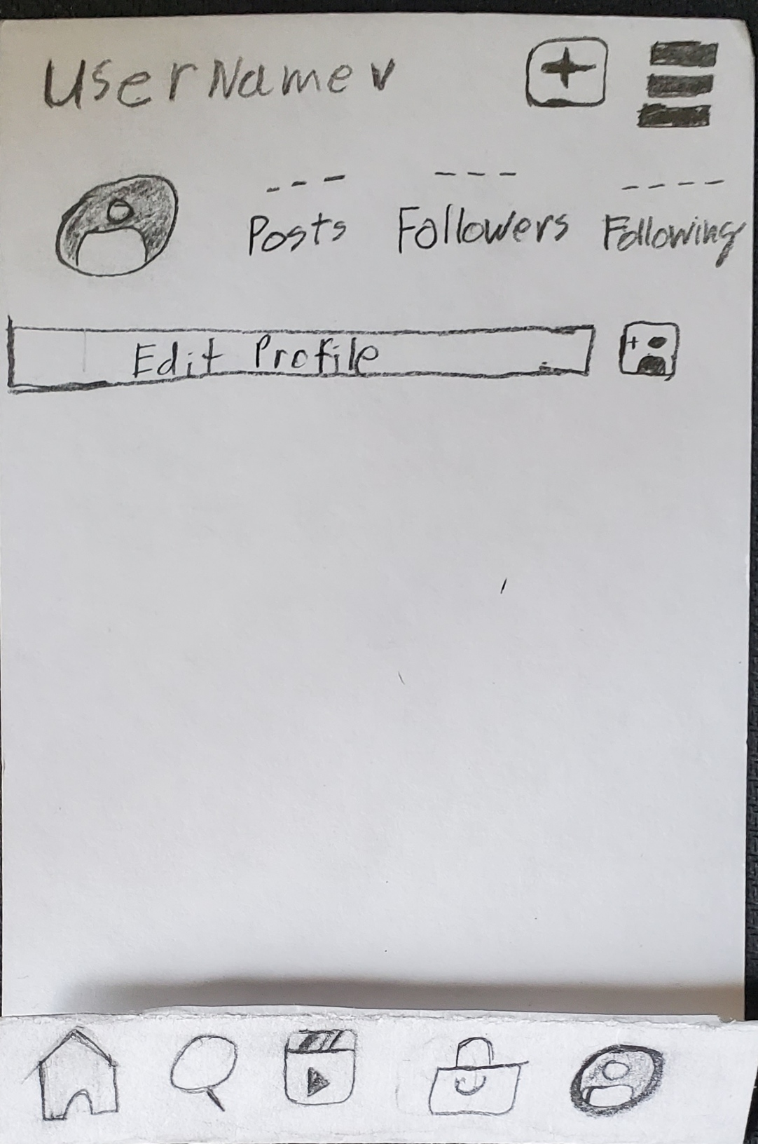
The Prototype: Step 2: Profile Screen

Slide 5
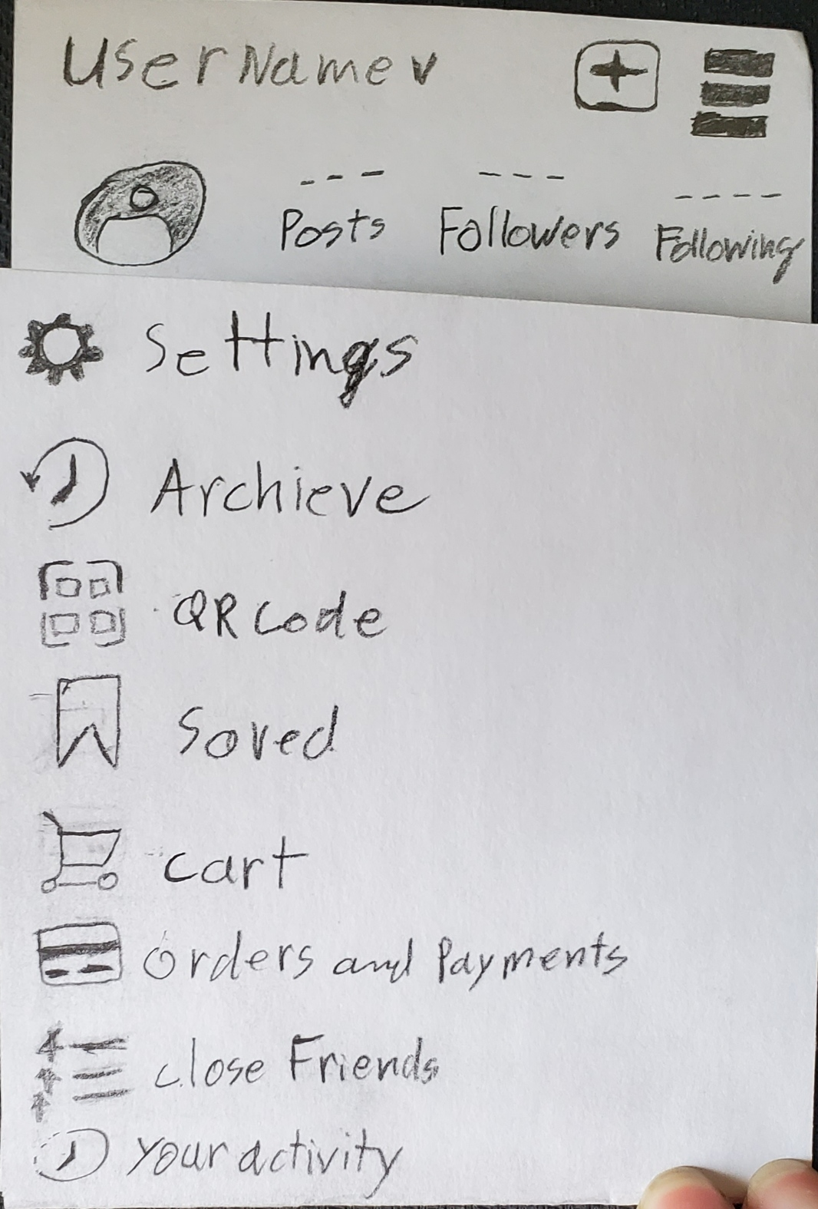
The Prototype: Step 3) Profile Options

Slide 6
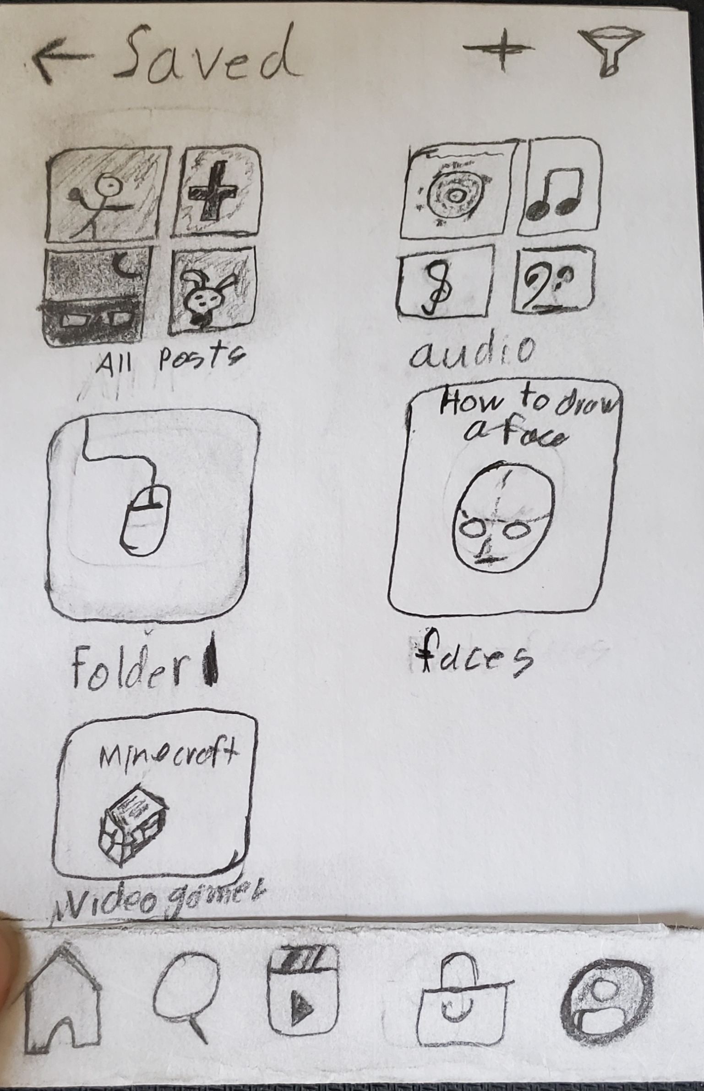
The Prototype: Step 4) “Saved Posts” Screen

Slide 7
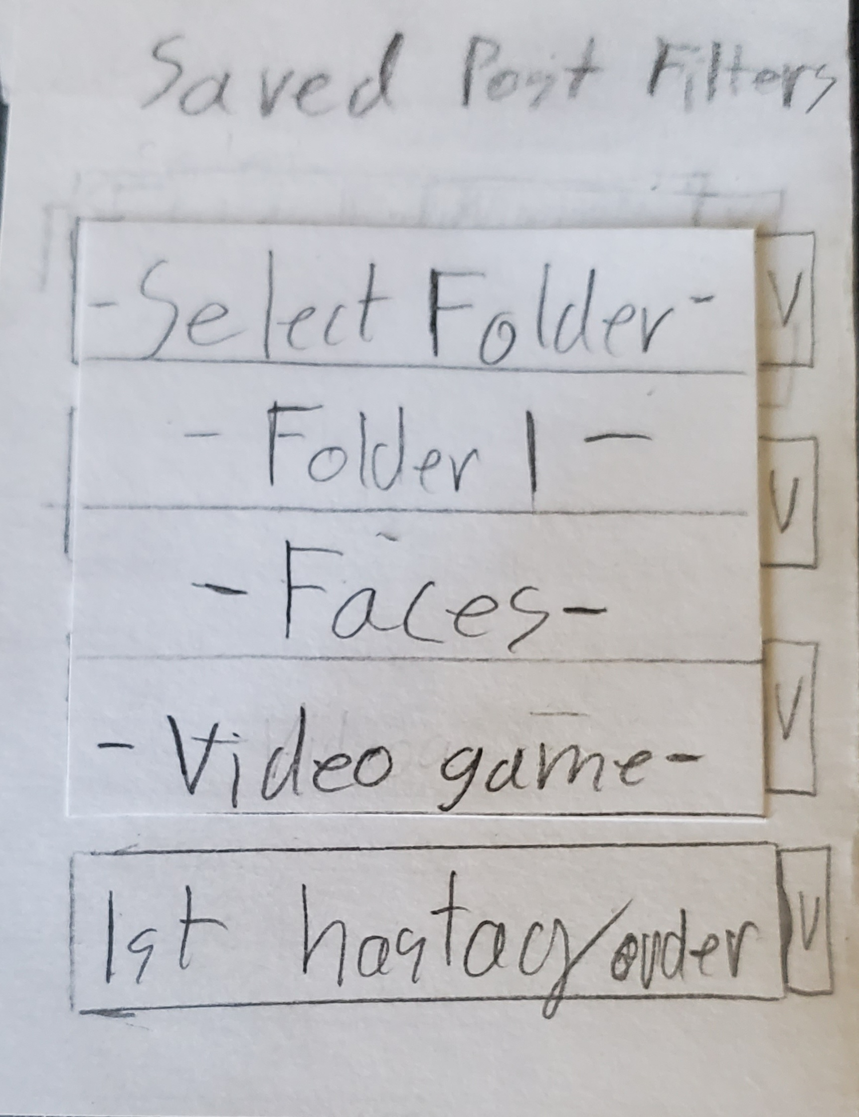
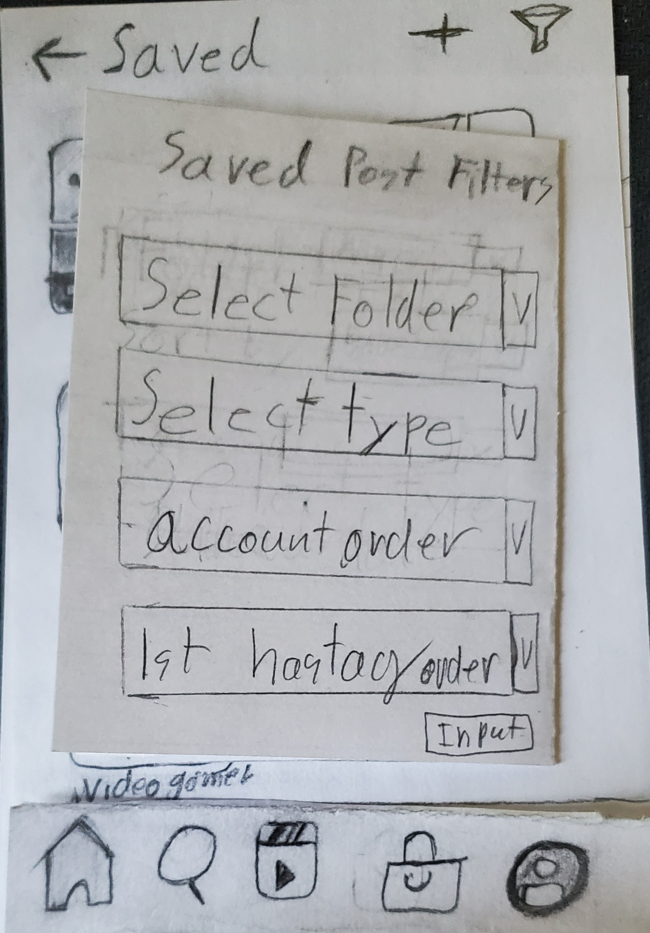
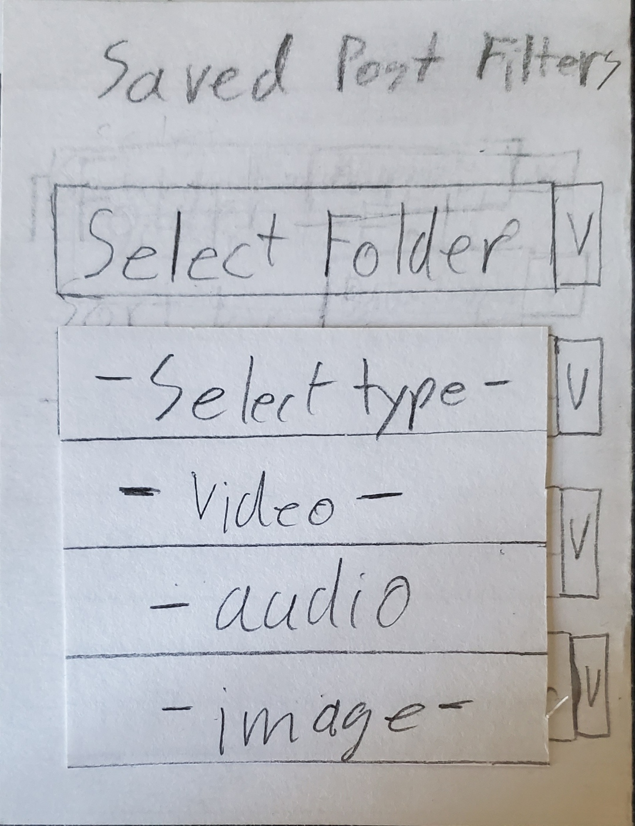
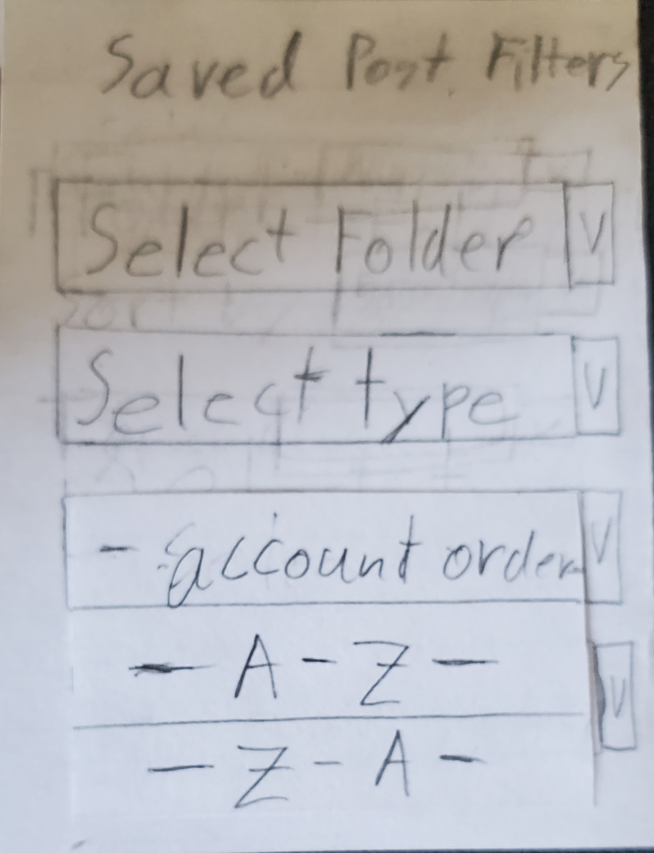
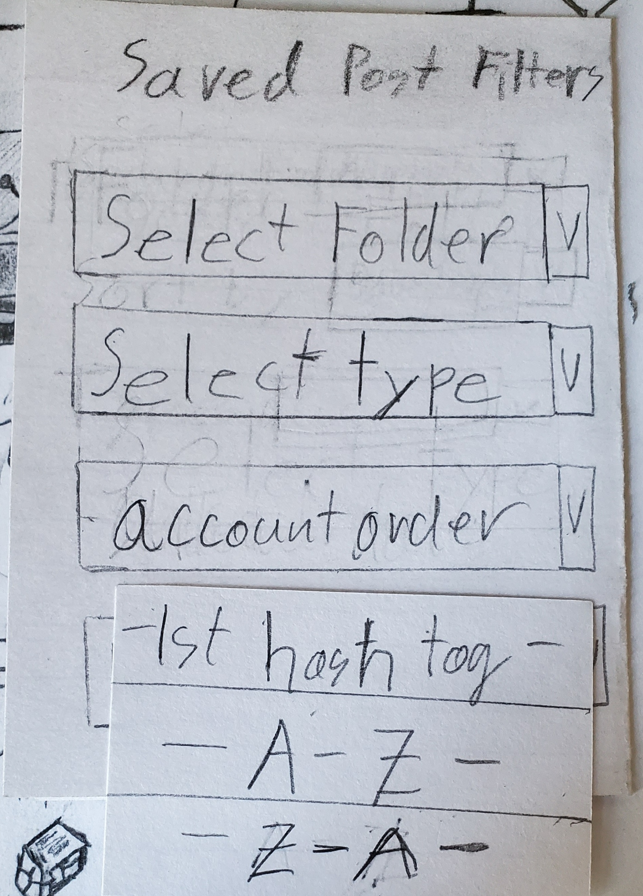
The Prototype: Step 5) Filter Settings

Slide 8
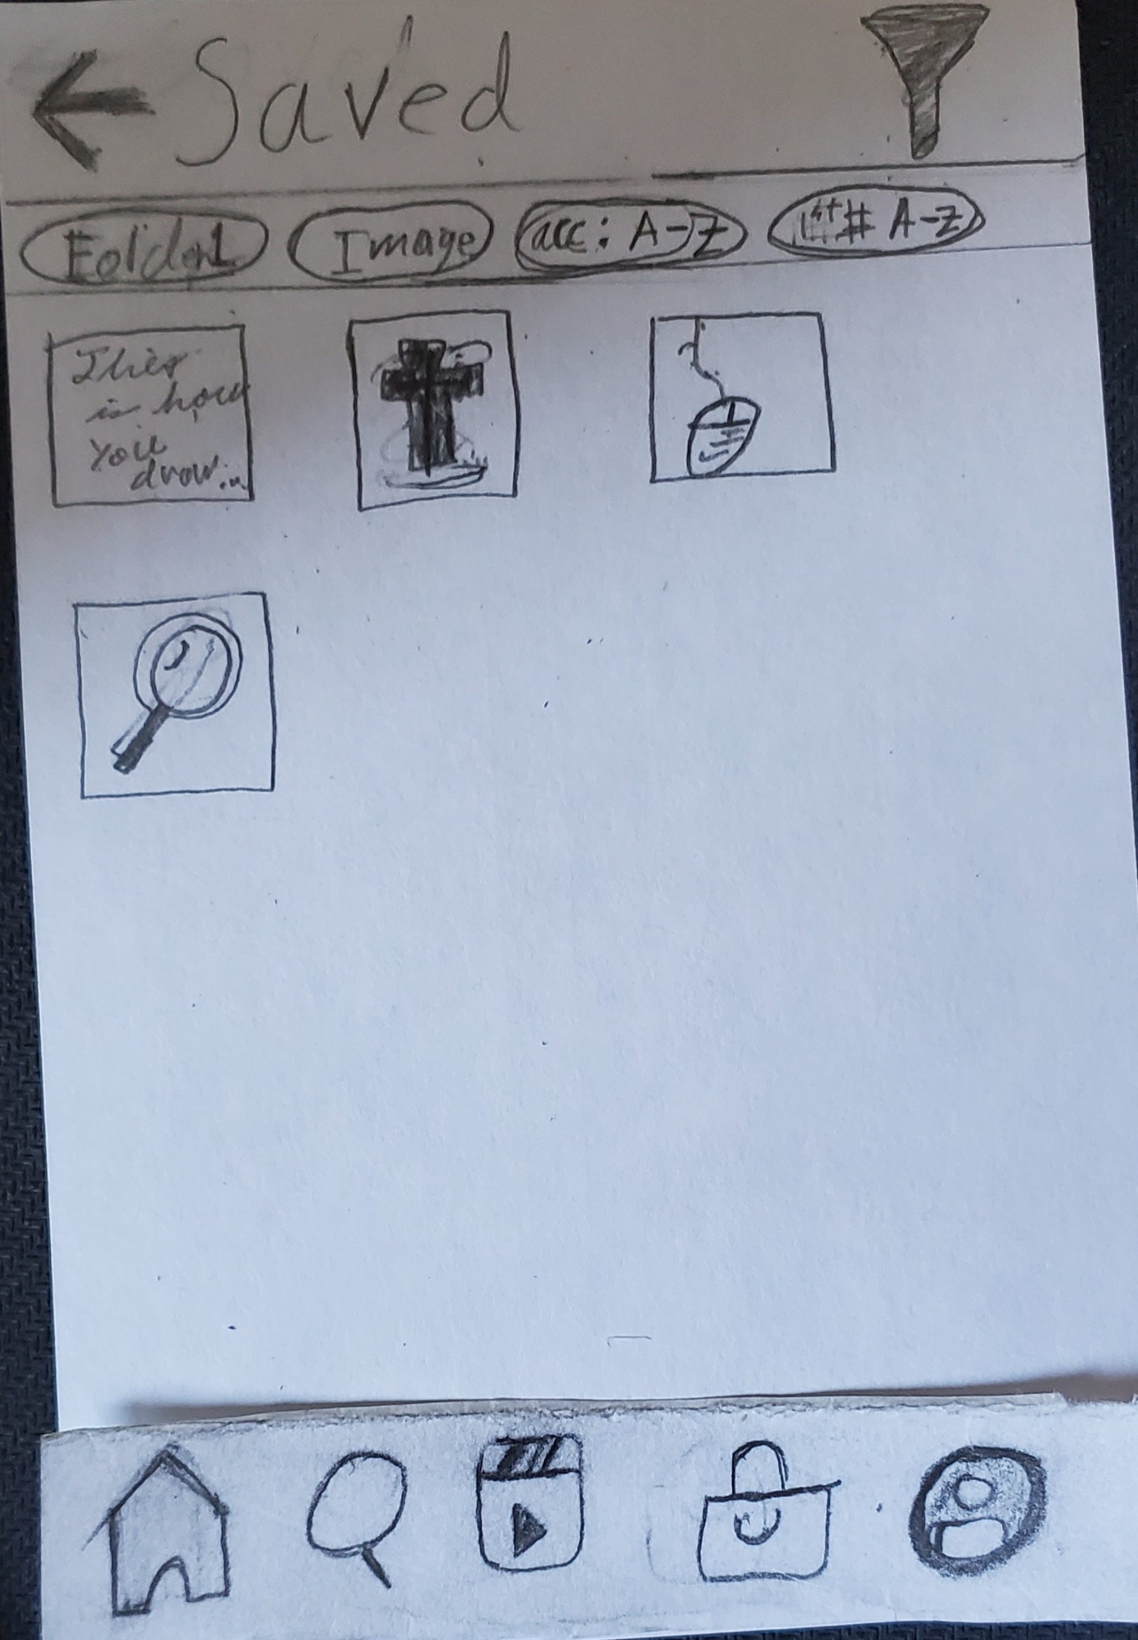
The Prototype: Step 6) After selecting Filters

Slide 9
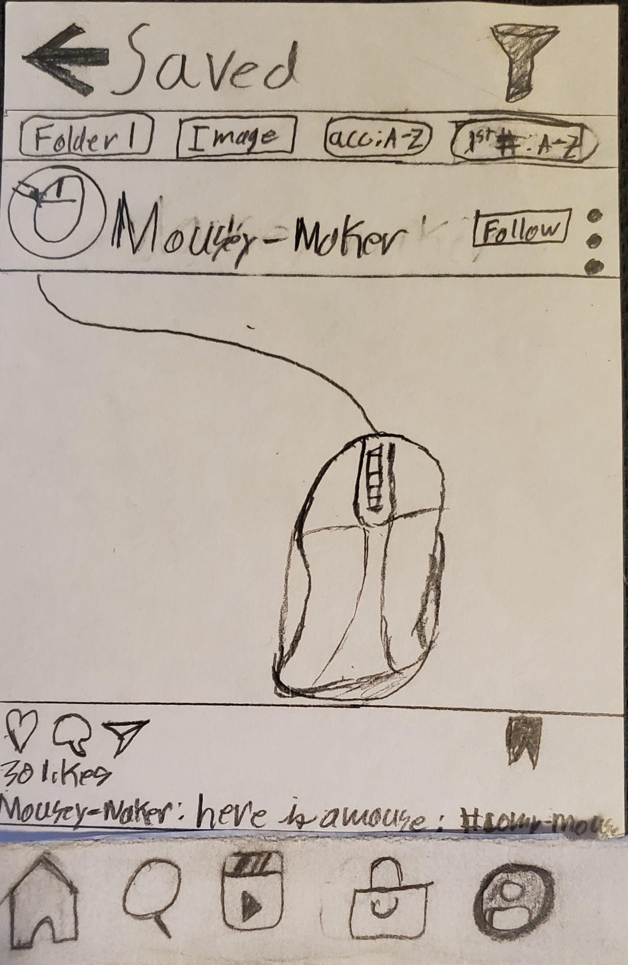
The Prototype: Step 7) Selecting the post

Slide 10
Overview:
All testers were able to reach the end goal of finding a selecting an image in the Saved posts. However, It was pointed out to me by Tester 3 that if there were more posts in a folder, it would still be difficult to find one post, so I added a Hashtag Search Option.

Slide 11
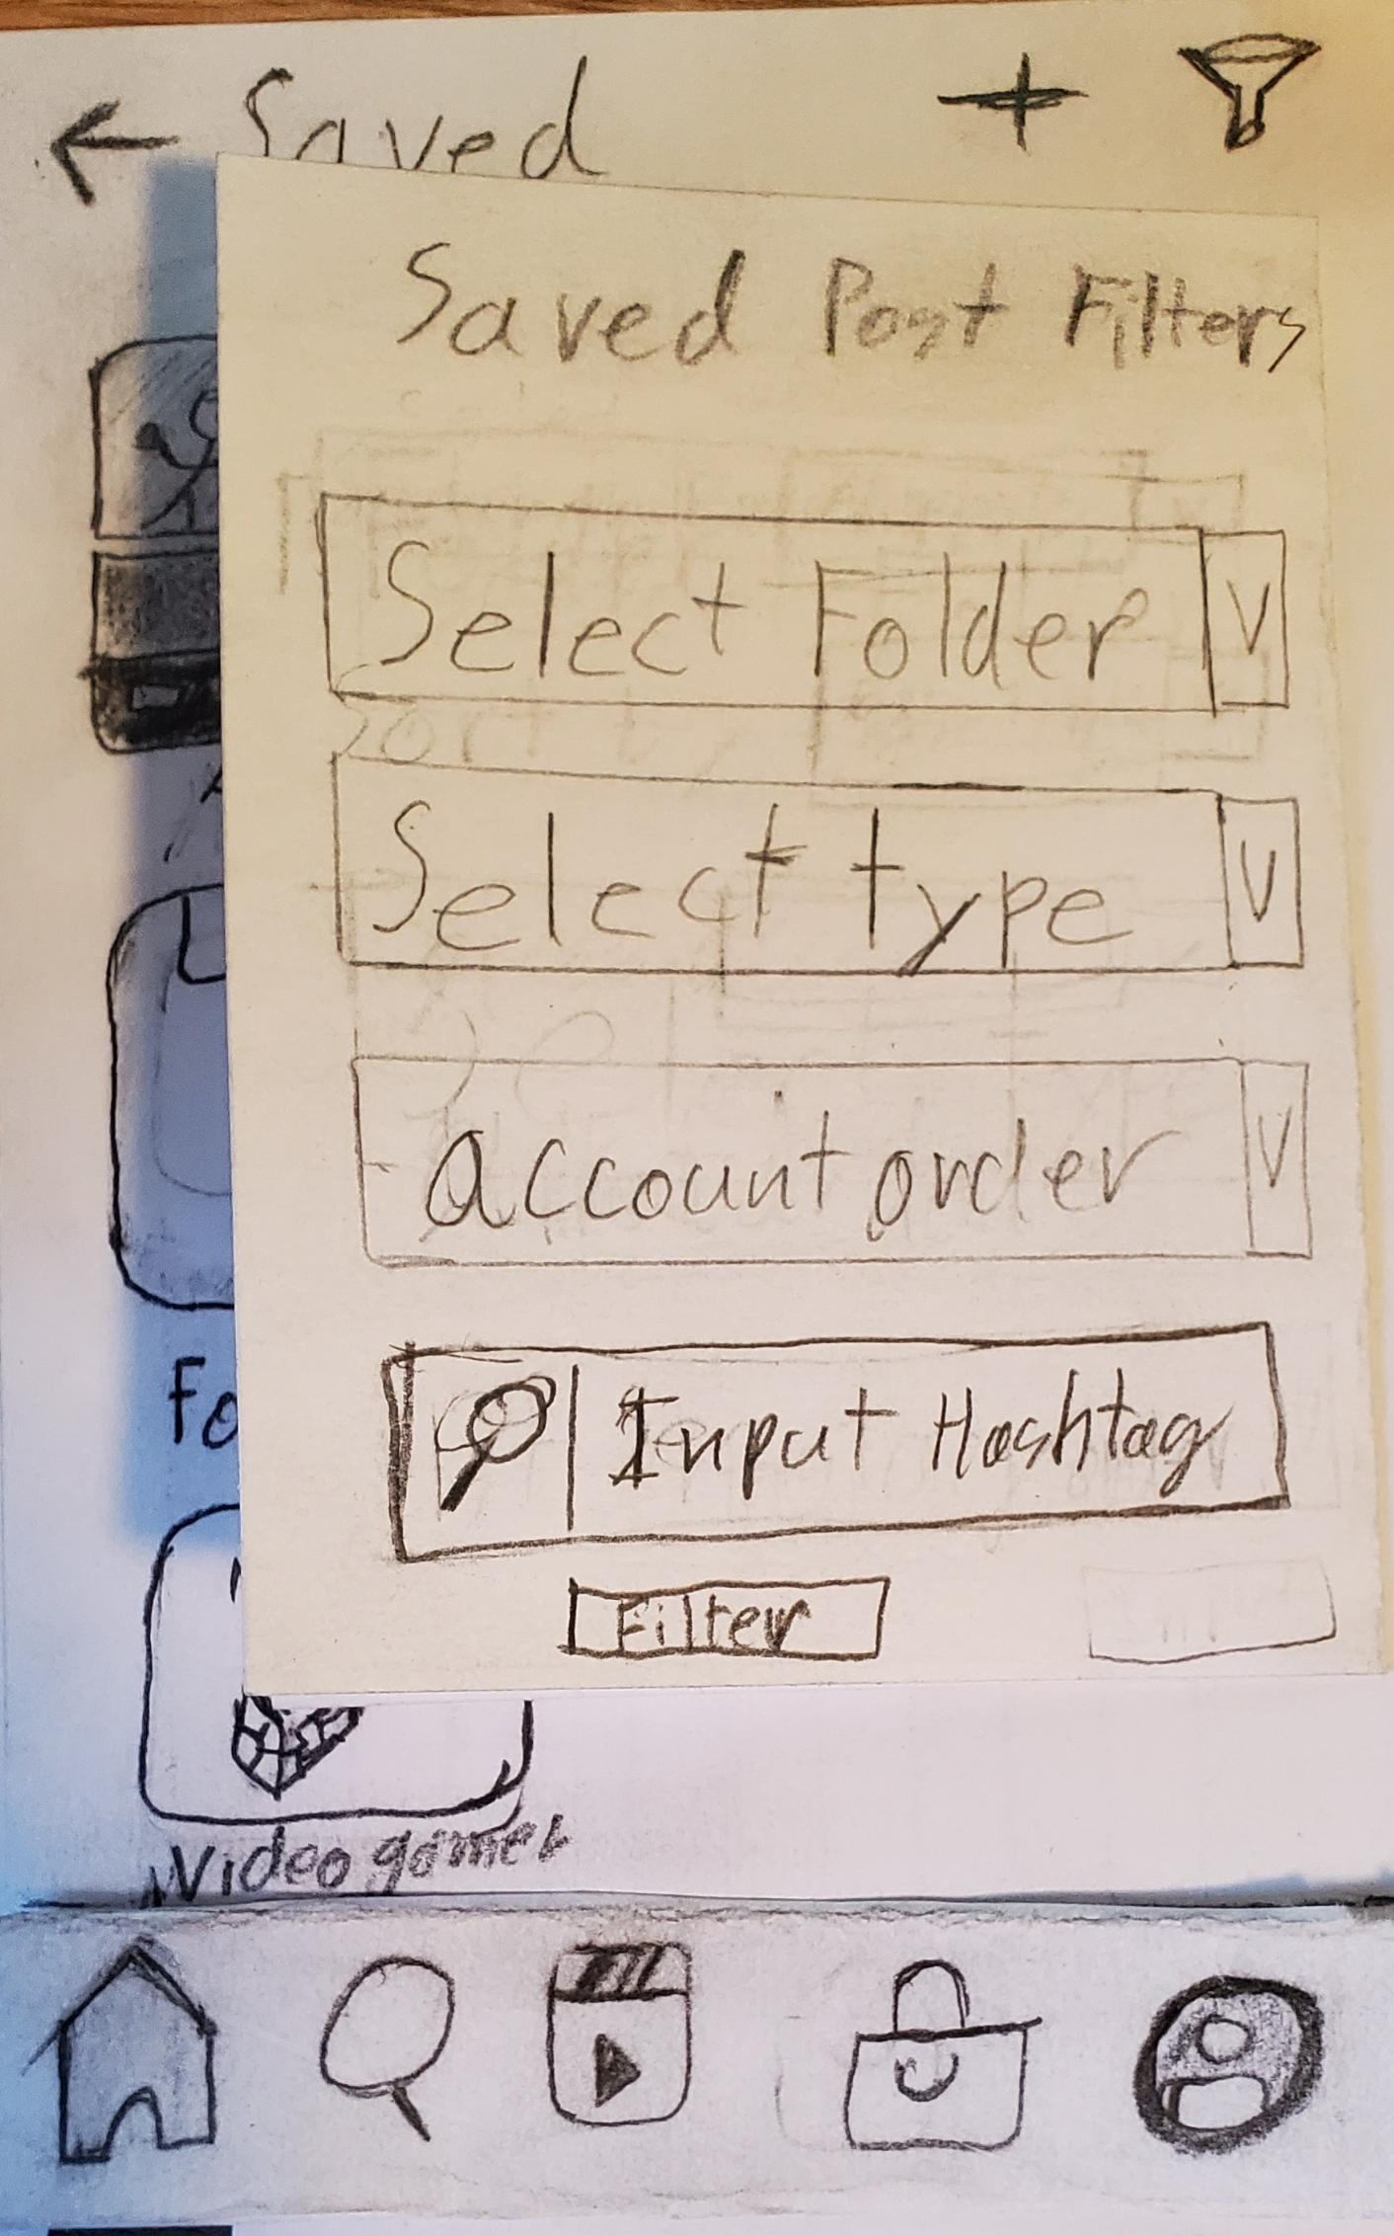
Prototype Revisions: Hashtag Search option in Filter Options

Slide 12
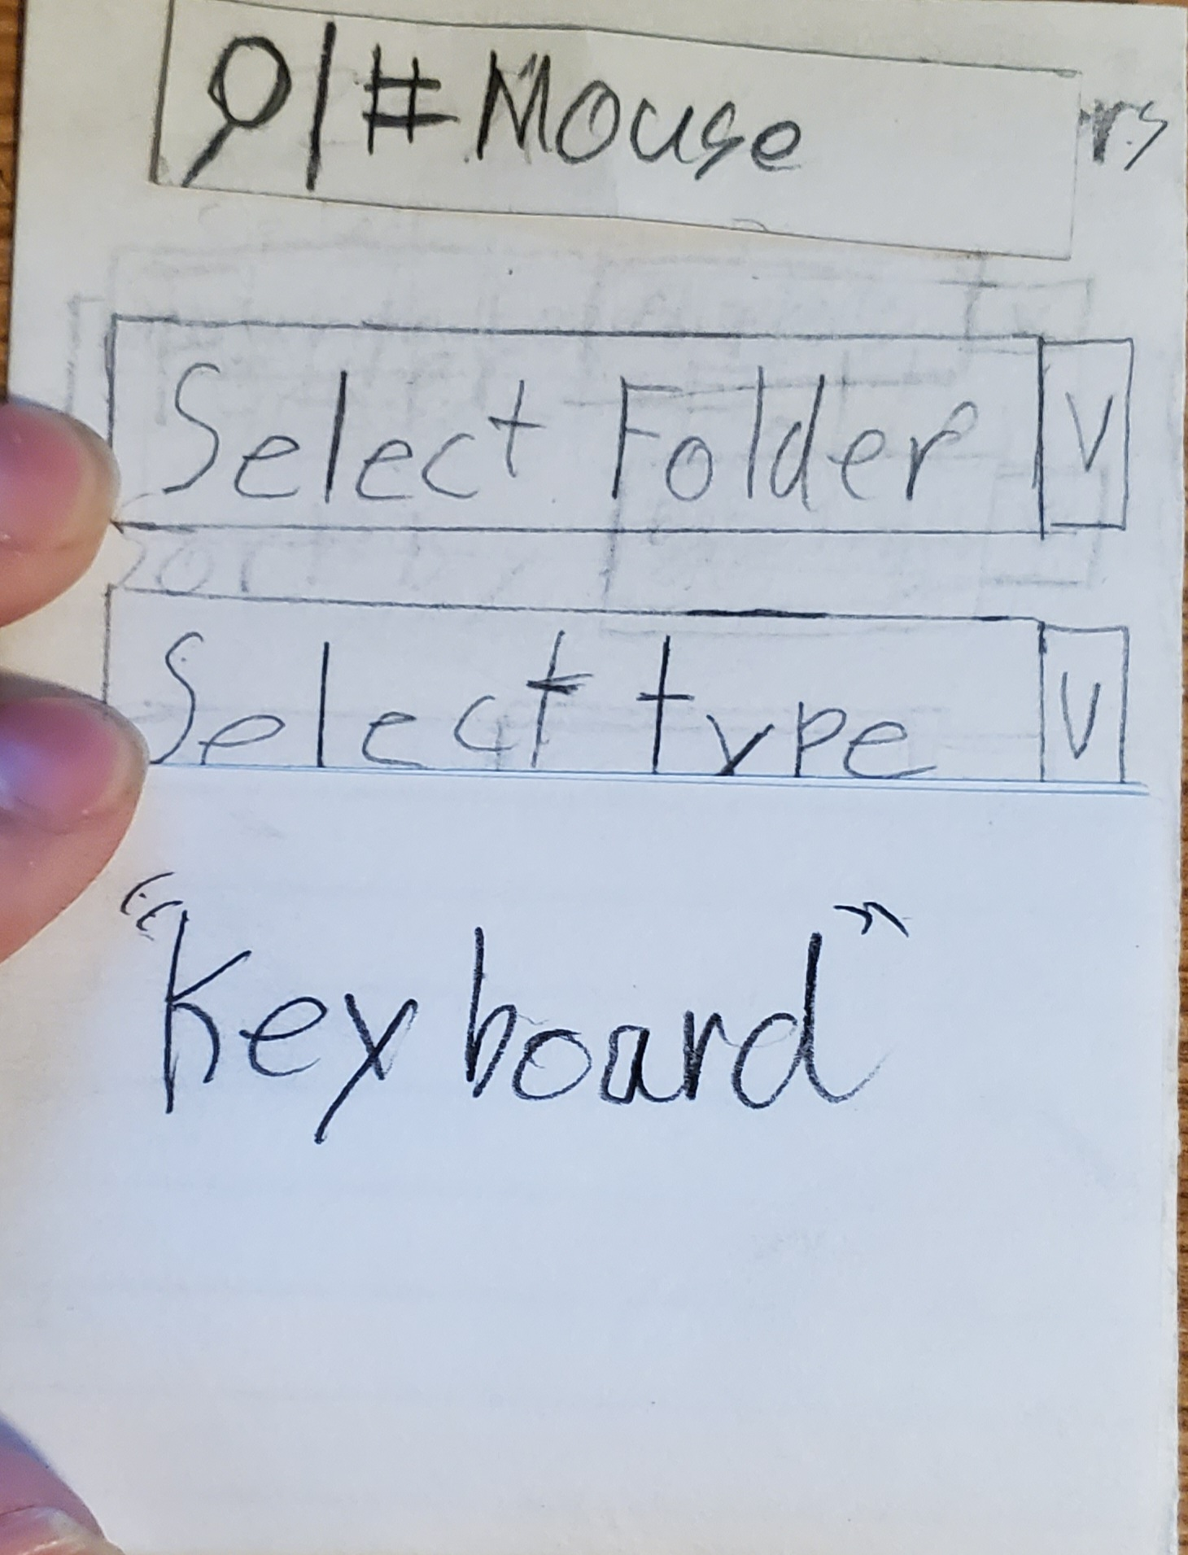
Prototype Revisions: Revised Step 5) Filter Options

Slide 13
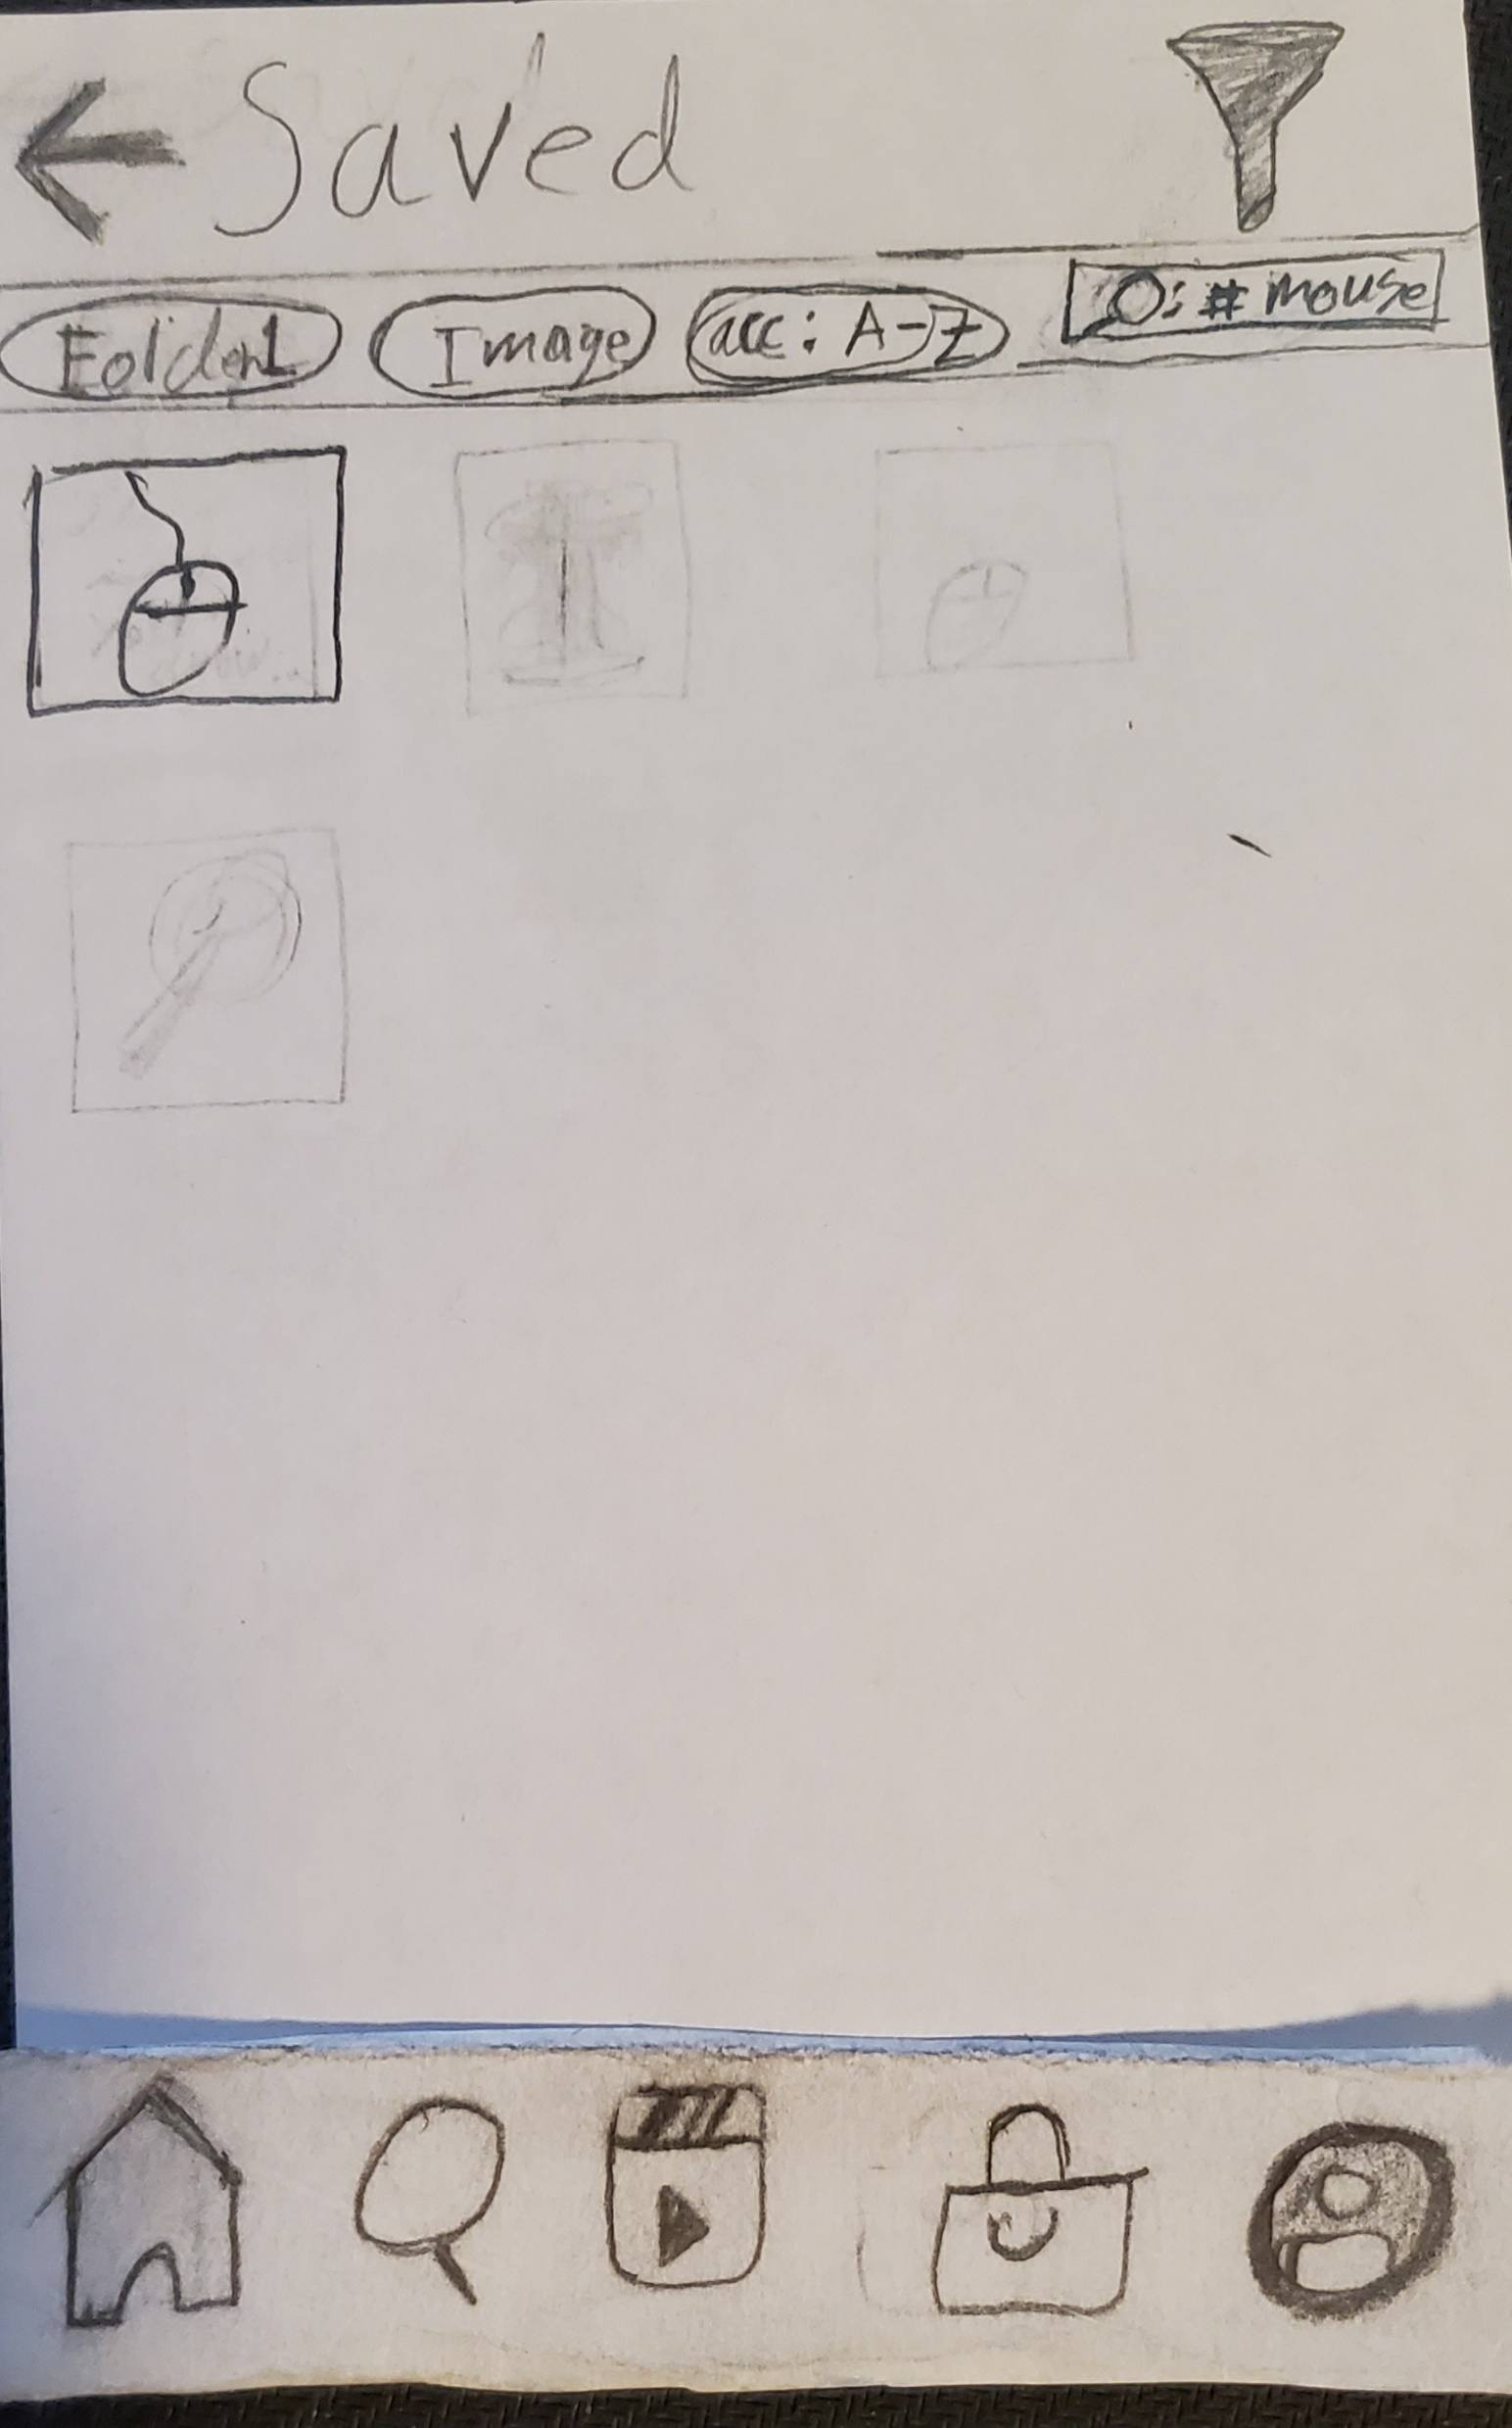
Prototype revisions: Revised Step 6) After Selecting the Filters

